Slide 1
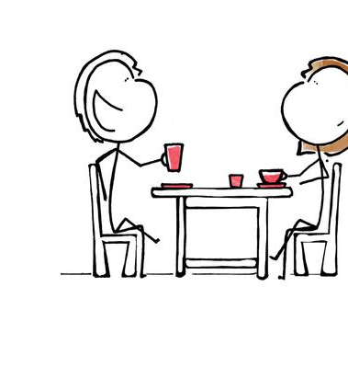
The Matchmaking Program
Jude Wentian Zhu
W200 Sec 5
Project 1

Slide 2
Program Design
A Scoring algorithm to rate a candidate (potentially from Tinder or Coffee Meets Bagel) according to the following characteristics:
Height, weight
Profession
Hobbies
Family Background (Parent’s highest education)
Decide if the user wants to go on first date with potential match
First date: Option to adjust score for the candidate’s look
Second – Fifth date:
Option to explore activities and add to common interests
Option to add bonus or subtract points
Control Flow:
From 2nd to 5th date, if score falls < 75, restart the program and select another candidate
From 2nd to 5th date, if score jumps over 100, the user finds a perfect match
At 5th date, if the average of 6 scores is > 90, considered a perfect match

Slide 3
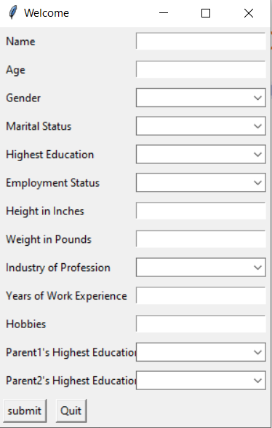
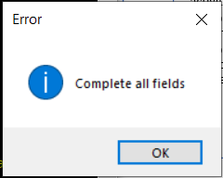
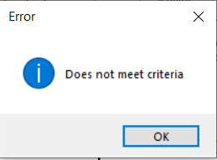
Program Flow
Input Prompt
Candidate's initial profile
Initial Score
If: initial score <75, go back to the first step to choose another candidate
1st date
User will adjust person’s attractiveness
2-5th date
After 5 dates
Possibility to add common hobby if both tries an activity
If: score <75, restart
If: score >100, perfect match, end program
If: average of six scores is >90 (initial score + date score) perfect match, end program
Else: go ahead and meet the person
Option to store comment
If: score <75, restart
Else: end program, take a break
Text Input
Error Catching
Select from dropdown menu
Fields are left blank
Text Input
Text Input
Does not meet criteria
(e.g. Age, Gender, Marital Status)
Select from dropdown menu

Slide 4

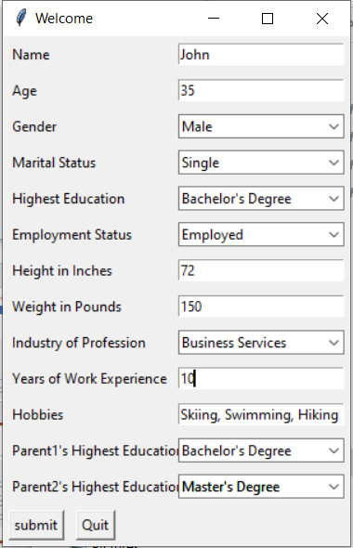

Demo – Program End/Start over
Trigger to End Program or start over before reaching 5th date
Or

Slide 5
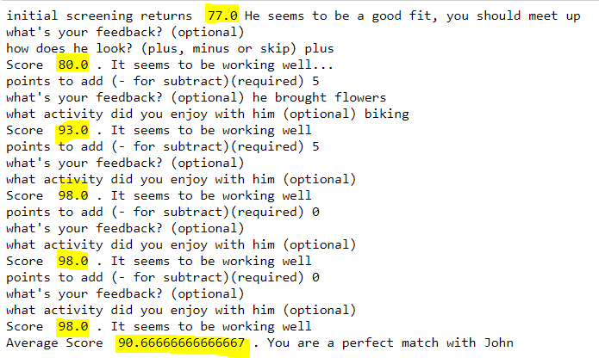
Demo – Program Runs to the End
Average of Prescreen Score and 5 dates score is > 90
Found a match, end program
If average is < 90
End program and take a break

Slide 6
Challenges
Tkinter
Declaring an object inside class
Potential Improvement
Expand the scope of screening criteria
Expand feedback options
A visual summary output

